Slide 1
Sports Analytics Case Study
Murach’s Python for Data Science– Chapter 14
How did Stepen Wardell Curry’s shooting performance and shot locations change across seasons?
By: Cole Williams
Date: November 12, 2026
Notes:
“Today, we’ll use Stephen Curry’s shot data to see how Python helps us answer a sports analytics question. We’ll load and clean the data, summarize his shooting by season, and visualize where he took his shots. Then you’ll calculate three-point accuracy in a short exercise.”

Slide 2
Getting started
Open Canvas -> navigate to discussion -> find lesson post
Click the GitHub link
Create a new folder on your desktop
In VS Code, open the Command Palette:
  Windows: Ctrl + Shift + P
  Mac: Cmd + Shift + P
CD <Your_Folder_Name_Here> git clone https://github.com/cwill4261/python_section_4_case_study
Open code/lesson_examples.py
Follow along with the lesson code provided, and then we’ll write our own changes during the practice exercise
Notes:
Canvas link: https://pacific.instructure.com/courses/153011/discussion_topics/548935
GitHub link: https://github.com/cwill4261/python_section_4_case_study

Slide 3
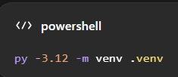


Set Up Python and Run the Lesson
Install the packages
  In VS Code, select Terminal -> New Terminal. Run these commands from the project folder:
Run the lesson
Windows commands shown. Mac/Linux commands are in the README. Close the first chart window to display the second.
Notes:
The virtual environment holds the packages for this project. The requirements file installs the versions I tested. Then we use that environment’s Python to run the lesson

Slide 4
Dataset and Scope
How did Stephen Curry’s shooting performance and shot locations change across seasons?
Source: Murach’s Chapter 15 sports analytics dataset
Seasons: 2009-2010 through 2018-2019
11,846 shot attempts in original dataset
Each row represents one shot attempt
Example:
Game date | Shot type | Result
October 28, 2009 | Three-pointer | Missed
October 28, 2009 | Two-pointer | Made
Our analysis focuses on regulation-time field goals. It excludes overtime and free throws.
Notes:
Before analyzing data, we need to understand what each row represents. Here, one row is one shot attempt. The records tell us when the shot happened, whether it was a two- or three-pointer, whether it went in, and where it was taken.

Slide 5
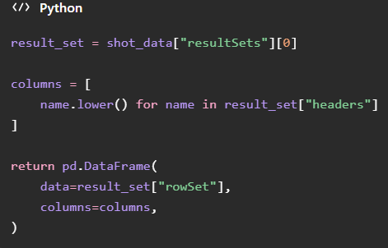
From JSON to a pandas DataFrame
shots.json → column names + shot records → DataFrame
Headers supplies the
column names
rowSet supplies the shot
records
DataFrame combines
them into a table
Notes:
What to demonstrate: switch to VS Code and point out load_shots() in lesson_examples.py. Explain that the preceding lines open the local JSON file; this excerpt builds the table.
What to say:
“JSON stores structured information. We extract the column names and shot records, then combine them into a pandas DataFrame. That gives us a table we can filter, calculate with, and summarize.”

Slide 6
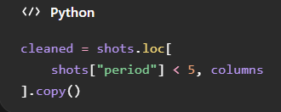
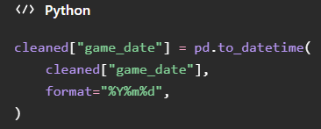
Cleaning the Data
Keep regulation-time shots: quarters 1–4
Keep the six columns needed for our analysis
Convert game dates into a usable date format
Result: 11,846 original attempts − 93 overtime attempts = 11,753 regulation-time attempts
Notes:
The filter keeps periods below five, which excludes overtime. We select the columns needed for this lesson and create a separate copy. Then we convert dates such as 20091028 into dates pandas can use to identify the year and month.
In VS Code, briefly point out the columns list in clean_shots(). Explain that selecting fewer columns keeps the lesson focused; the removed columns could still be useful for other questions.

Slide 7
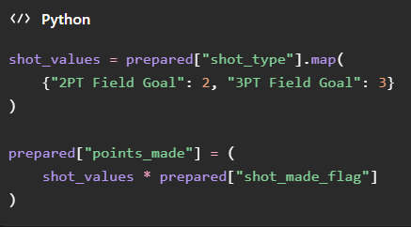
Prepare the Data
New column | Example | Purpose
season | 2015-2016 | Group shots by basketball season
shot_result | Made or Missed | Label results for the charts
points_made | 0, 2, or 3 | Calculate field-goal points
Notes:
“We turn the existing information into columns that answer our questions. Season labels let us compare years, made/missed labels make the charts readable, and multiplying shot value by the result flag gives us the points from each attempt.”
Briefly point out get_season() in VS Code and explain that it uses the textbook’s July cutoff to assign a season.
Allow about two minutes. Next, we’ll summarize individual shots into game and season statistics.

Slide 8
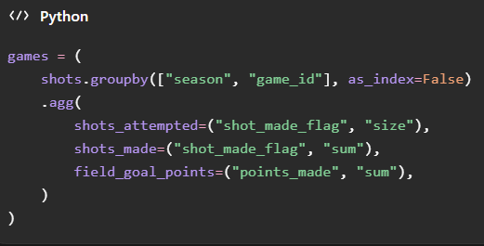
Summarize with groupby()
Individual shots -> game totals -> season averages
Groupby() collects shots from the same game
Size counts attempts
Sum counts makes or adds points
We then group the game totals by season to calculate averages.
Season shooting percentage = total makes ÷ total attempts × 100
Notes:
Each row starts as one shot. Grouping by game lets us count attempts, count made shots, and total field-goal points. We then summarize those games by season. Because made shots are labeled one and misses zero, adding that column counts the makes.

Slide 9
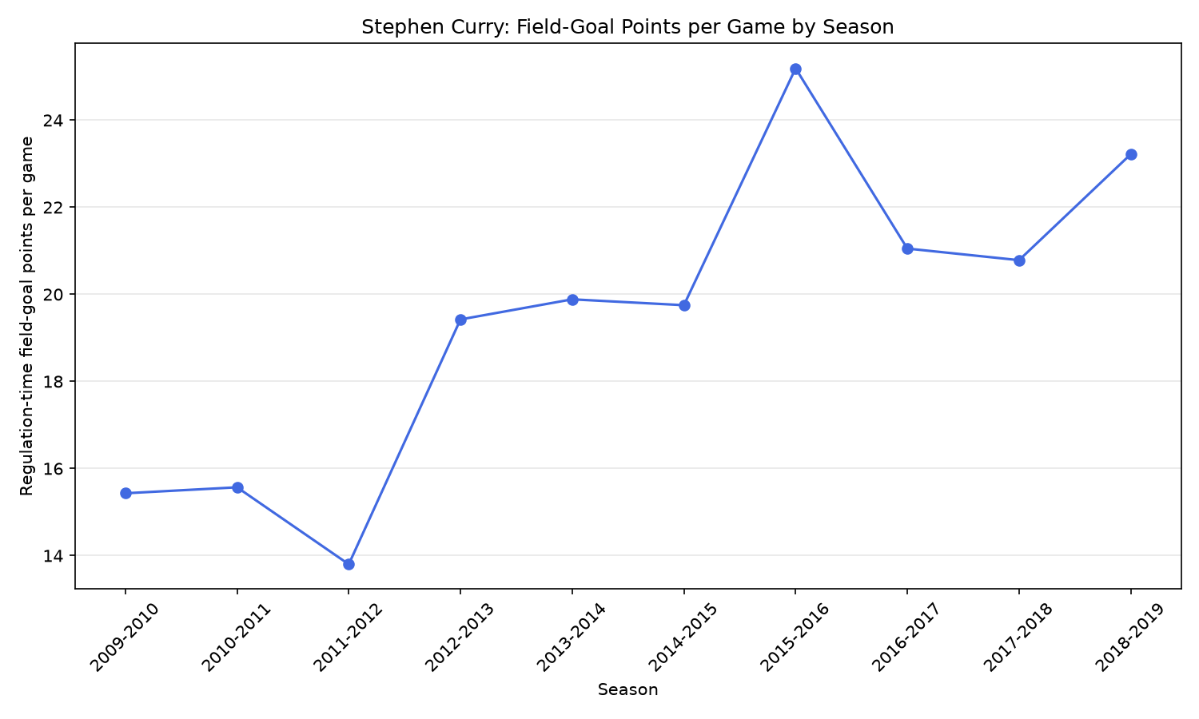
What Changed Across Seasons?
The average rises from 15.43 field-goal points per game in 2009–2010 to 25.19 in 2015–2016.
2015–2016 is the highest season shown for this measure.
Regulation-time field goals only; excludes free throws and overtime.
Notes:
What to say: Now we can see what our grouping and calculations produced. Each point represents the average field-goal points per recorded game for a season. The highest value shown is 2015–2016. This describes the scoring pattern, but the chart alone doesn’t explain why it changed.
Follow-along instruction: Run lesson_examples.py if you haven’t already. Look at the season summary in your terminal and find the 2015–2016 row.

Slide 10
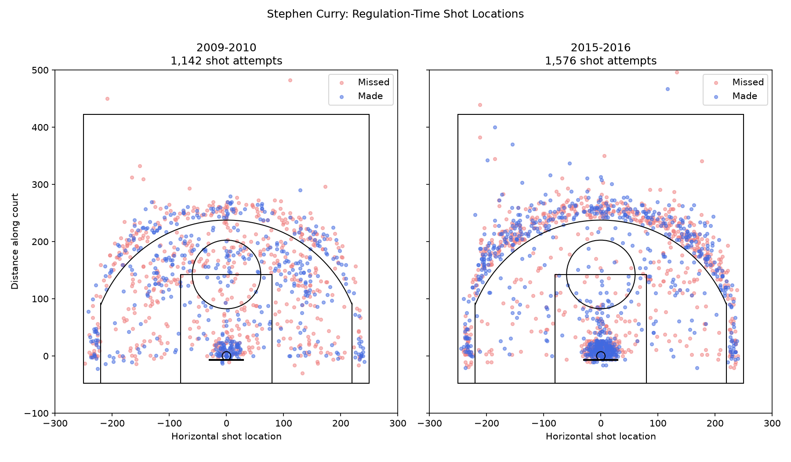
Where Did Curry Shoot?
Each dot represents one shot attempt
Blue = made
Red = missed
Both seasons use the same coordinate scale
Half-court view: attempts outside the plotting limits are not displayed.
Notes:
This chart compares Curry’s shot locations in 2009–2010 and 2015–2016. The court outline helps us interpret the coordinates. We can explore where attempts cluster, but overlapping dots make exact comparisons difficult.
What differences do you notice in where the shots were taken?
Follow-along instruction: close the first chart window to display this second chart. In VS Code, briefly point out that plot_shot_locations() draws the shots and draw_court() adds the reference shapes; there’s no need to explain every court coordinate.

Slide 11
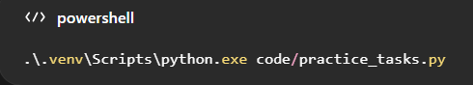
Your Turn – Calculate Three-Point Accuracy
Open code/practice_tasks.py.
Keep the season set to "2015-2016" for our shared comparison.
Complete TODO 2: keep only three-point attempts.
Complete TODO 3: calculate shooting percentage.
Save and run the script.
Hints:
Filter using shot_type and the value "3PT Field Goal".
Shooting percentage = makes ÷ attempts × 100
Finished early?
Complete TODO 1 by choosing another season and comparing the results.
Notes:
Now you’ll apply the filtering and calculation steps yourself. The starter currently includes all shot types, so your first job is to keep only three-pointers. Then calculate the percentage that were made.

Slide 12
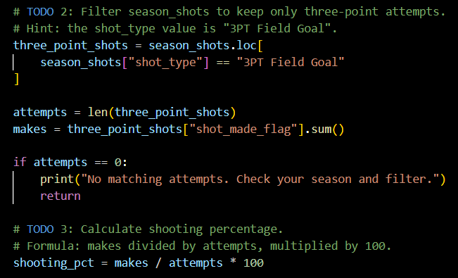
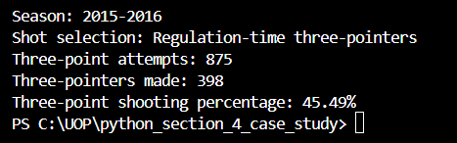
Check Your Answer
Expected Code:
Expected Output:
Notes:
What to say: The filter keeps only three-point attempts. We divide 398 makes by 875 attempts and multiply by 100, giving 45.49%.
Troubleshooting note: Seeing 1,576 attempts and 796 makes? You’re still counting all field-goal attempts. Check your TODO 2 filter and save the file before running again.

Slide 13
Key Takeaways and Questions
Python turns raw records into useful summaries: load → clean → prepare → summarize → visualize.
2015–2016 had the highest regulation-time field-goal points per game among the seasons in this dataset: 25.19.
Filtering changes the question: three-point accuracy uses three-point makes and attempts, rather than all field goals.
Notes:
We started with individual shot records and used Python to create season summaries and location charts. You then used filtering to answer a more specific question about three-point accuracy. The same workflow can be applied to many other datasets.

Slide 14
Sources
Mike Murach & Associates, Inc. (n.d.). [Stephen Curry shot data] [Data set]. https://www.murach.com/python_analysis/shots.json

